Slide 1
Module 9 Part 3
Security Technology & Tools
Harvinder S Jabbal
SSZG653 Software Architectures

Slide 2
Contents
Transport Layer Security (TLS)
OpenID & OpenAuth
LDAP
Identity & Access management
Firewalls
November 4, 2023
SE ZG651/ SS ZG653 Software Architectures

Slide 3
Introduction
The objective of this session is to provide an introduction to a few important technology topics.
November 4, 2023
SE ZG651/ SS ZG653 Software Architectures

Slide 4
Transport layer security (TLS)
(Older version is SSL)
Used for secure communication between client & server (example between browser and a web site)
It provides
  Privacy: No intruder can know what communication is going on
  Data integrity: Data being communicated can not be modified by an intruder. If he does, it can be detected
November 4, 2023
SE ZG651/ SS ZG653 Software Architectures

Slide 5
TLS: How does it work?
Client & server do the following:
Agree on the version of the TLS protocol to use.
Select cryptographic algorithms to use
Authenticate each other by validating digital certificates.
Generate a shared secret key, for the symmetric encryption of messages (This is faster than asymmetric encryption)
November 4, 2023
SE ZG651/ SS ZG653 Software Architectures
Source: https://www.ibm.com/support/knowledgecenter/en/SSFKSJ_7.1.0/com.ibm.mq.doc/sy10660_.htm

Slide 6
Encryption algorithms used
Key Exchange Algorithms (RSA, DH, ECDH, DHE, ECDHE, PSK)
Authentication/Digital Signature Algorithm (RSA, ECDSA, DSA)
Bulk Encryption Algorithms (AES, CHACHA20, Camellia, ARIA)
Message Authentication Code Algorithms (SHA-256, POLY1305)
November 4, 2023
SE ZG651/ SS ZG653 Software Architectures

Slide 7
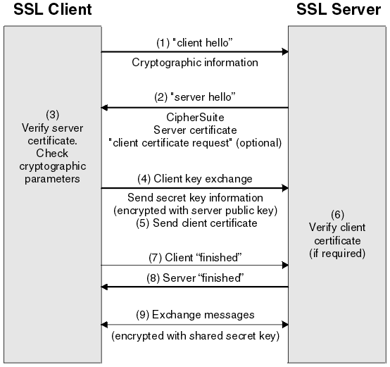
TLS / SSL steps
November 4, 2023
SE ZG651/ SS ZG653 Software Architectures
Source: https://www.ibm.com/support/knowledgecenter/en/SSFKSJ_7.1.0/com.ibm.mq.doc/sy10660_.htm

Slide 8
OpenID
We use several websites.
One issue we face is, remembering user ids & passwords of several websites
With OpenID technology, we can use a single account, such as Facebook, Google or Yahoo, to sign-in to thousands of websites
November 4, 2023
SE ZG651/ SS ZG653 Software Architectures

Slide 9
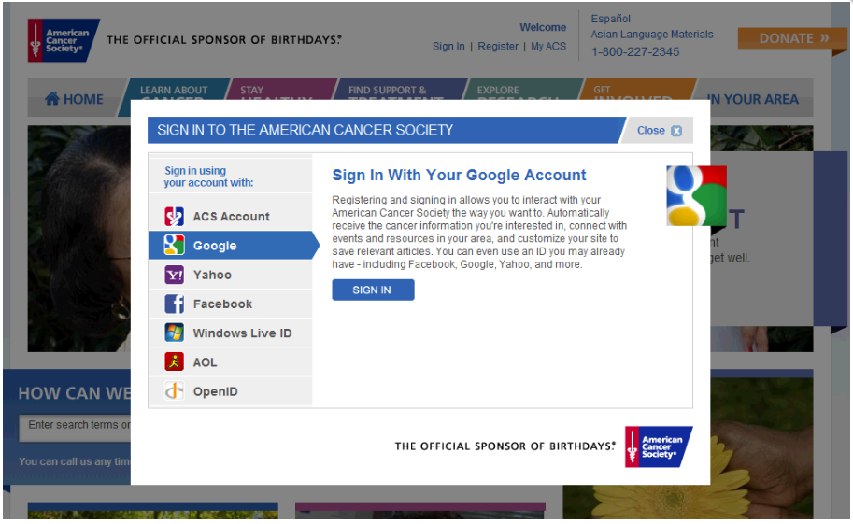
Sample login page: American Cancer Society
November 4, 2023
SE ZG651/ SS ZG653 Software Architectures

Slide 10
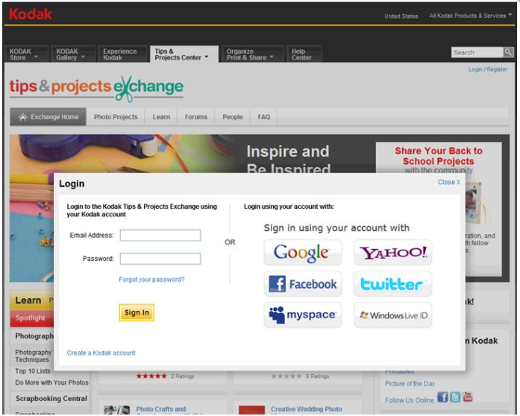
Sample login page: Kodak Tips and project Exchange
November 4, 2023
SE ZG651/ SS ZG653 Software Architectures

Slide 11
OpenID: How does it work?
(One typical approach)
The website redirects the user to an OpenId provider such as Facebook or Google
The OpenID provider authenticates the user
The user is redirected back to the website along with the end-user's credentials (such as user id, but not the password)
Reference: https://en.wikipedia.org/wiki/OpenID
November 4, 2023
SE ZG651/ SS ZG653 Software Architectures

Slide 12
OAuth
OpenID is to authenticate users.
OAuth authorizes a client to access your data stored in another website such as Yahoo (data such as your profile, contacts in Yahoo)
Reference: https://tools.ietf.org/html/draft-ietf-oauth-use-cases-01#section-2.1
November 4, 2023
SE ZG651/ SS ZG653 Software Architectures

Slide 13
OAuth: Use cases
Use case 1:
  An application can use OAuth to obtain permission from users to store files in their Google Drives.
Use case 2
  A photo printing application (www.printphotos.example.com) can access your photographs stored on a server www.storephotos.example.com and then print them
Reference: https://tools.ietf.org/html/draft-ietf-oauth-use-cases-01#section-2.1
November 4, 2023
SE ZG651/ SS ZG653 Software Architectures

Slide 14
OAuth: How does it work?
You try to log onto a website and it offers opportunities to log on using Google, Yahoo, etc. Let us say you choose Google.
You are redirected to Google
Google authenticates you, and returns a token to the website.
The token enables the website to login to Google as you, and access resources such as your contacts.
https://www.csoonline.com/article/3216404/what-is-oauth-how-the-open-authorization-framework-works.html
November 4, 2023
SE ZG651/ SS ZG653 Software Architectures

Slide 15
LDAP: Lightweight Directory Access Protocol
Scenario suitable for LDAP
Imagine you have a website that has a million registered users with thousands of page requests per second.
By using LDAP, you can easily offload the user validation and gain significant performance improvement.
Good use cases for LDAP:
  You need to locate ONE piece of data many times and you want it fast
  You don’t update, add, or delete the data very often
  The size of each data entry is small
November 4, 2023
SE ZG651/ SS ZG653 Software Architectures
https://stackoverflow.com/questions/239385/what-is-ldap-used-for

Slide 16
LDAP
LDAP is an Internet protocol to talk to a Directory service such as Active Directory of Microsoft
Directory services store information in a tree structure
LDAP is used in many open source solutions such as Docker, Kubernetes, Jenkins, etc.
November 4, 2023
SE ZG651/ SS ZG653 Software Architectures

Slide 17
Identity & Access management
Identity and access management (IAM), is a framework for ensuring that people in an enterprise have the appropriate access to technology resources.
IAM solutions are typically used in large organizations to ensure regulatory compliance.
Features of IAM
  Authentication of a user
  Authorization to use applications
  Definition of Roles. A User belonging to a group is authorized to perform certain operations defined for the role. Operations such as create sales order, approve credit card request, etc.
  Delegation of permission to another user
  Interchange identify information with trusted entities using OpenID, etc.
November 4, 2023
SE ZG651/ SS ZG653 Software Architectures

Slide 18
Leading Identity & Access management products
Azure Active Directory
IBM Security Identity and Access Assurance
Oracle Identity Cloud Service
Okta
November 4, 2023
SE ZG651/ SS ZG653 Software Architectures

Slide 19
Firewall
A firewall is a network security device that monitors incoming and outgoing network traffic and decides whether to allow or block specific traffic based on a defined set of security rules.
November 4, 2023
SE ZG651/ SS ZG653 Software Architectures

Slide 20
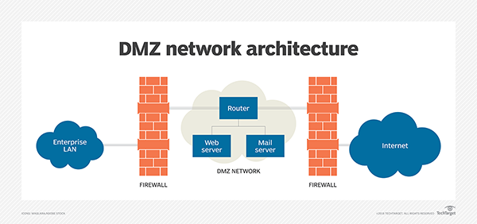
De-Militarized Zones (DMZ)
DMZ acts a buffer between Internet and organization network
November 4, 2023
SE ZG651/ SS ZG653 Software Architectures
https://searchsecurity.techtarget.com/definition/DMZ

Slide 21
How DMZs work?
DMZs are intended to function as a sort of buffer zone between the public internet and the organizational network.
If a better-prepared threat actor is able to get through the first firewall, they must then gain unauthorized access to those services before they can do any damage
November 4, 2023
SE ZG651/ SS ZG653 Software Architectures

Slide 22
Some Firewall features
Intrusion detection: Identify & block security threats such as malware, spyware, etc.
Grant access to users based on business need
Fingerprint applications and track their usage: # users, bandwidth usage
Allocate bandwidth to applications (ex. Allocate more BW to SalesForce.com and less to YouTube)
https://www.cio.com.au/article/365101/top_seven_firewall_capabilities_effective_application_control/
https://www.fortinet.com/products/next-generation-firewall.html#services
https://www.securedgenetworks.com/blog/11-Features-to-Look-for-in-Your-Next-Generation-Firewall
November 4, 2023
SE ZG651/ SS ZG653 Software Architectures

Slide 23
Firewall techniques
Techniques used:
Packet filtering: Looks at IP address and Port # and drops packets coming from or destined to certain IP addresses
Circuit level gateways: Detect conversations by looking at end-point pairs
Application layer filtering: Detects applications trying to use disallowed protocols or ports
Hide addresses and perform network address translation.
  Hacker can not know the IP address of the server that receives the message. Even if it knows, the firewall will block it.
November 4, 2023
SE ZG651/ SS ZG653 Software Architectures

Slide 24
Appendix
November 4, 2023
SE ZG651/ SS ZG653 Software Architectures

Slide 25
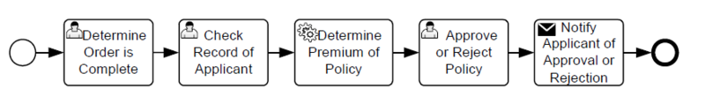
Business Process Management
Business Process Management Tools: Business Process Management (BPM) tools are used for automating, measuring and optimizing business processes.
BPM tools use workflow and collaboration to provide meaningful metrics to business leaders
Example: Appian, Zoho
November 4, 2023
SE ZG651/ SS ZG653 Software Architectures

Slide 26
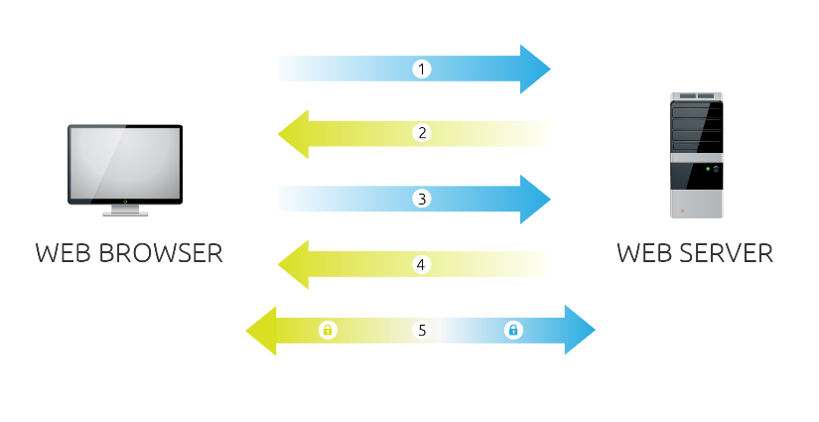
SSL
Browser connects to a web server (website) secured with SSL (https). Browser requests that the server identify itself.
Server sends a copy of its SSL Certificate, including the server’s public key.
Browser checks the certificate root against a list of trusted CAs and that the certificate is unexpired, unrevoked, and that its common name is valid for the website that it is connecting to. If the browser trusts the certificate, it creates, encrypts, and sends back a symmetric session key using the server’s public key.
Server decrypts the symmetric session key using its private key and sends back an acknowledgement encrypted with the session key to start the encrypted session.
Server and Browser now encrypt all transmitted data with the session key.
November 4, 2023
SE ZG651/ SS ZG653 Software Architectures

Slide 27
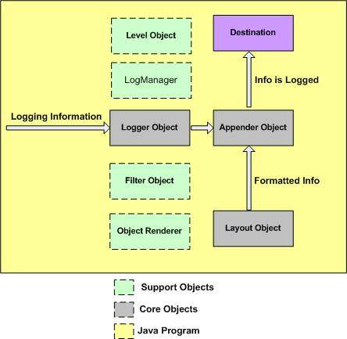
Logging: Apache Log4j
Database, file, console, UNIX Syslog, etc.
Logging is an important component of the software development.
A well-written logging code offers quick debugging, easy maintenance, and structured storage of an application's runtime information.
Logging does have its drawbacks also. It can slow down an application.
capturing logging information
format logging information
November 4, 2023
SE ZG651/ SS ZG653 Software Architectures

Slide 28
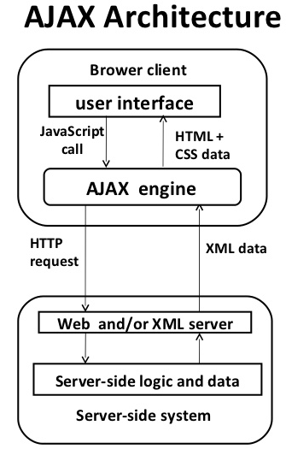
Asynchronous operation
AJAX stands for Asynchronous JavaScript and XML.
AJAX is a new technique for creating better, faster, and more interactive web applications with the help of XML, HTML, CSS, and Java Script.
Some famous web applications that use AJAX:
Google Maps (Drag entire map)
Google Suggest (Google suggests as you type)
November 4, 2023
SE ZG651/ SS ZG653 Software Architectures

Slide 29
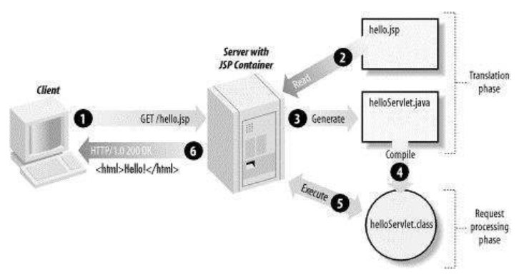
Simple Web application architecture
Dynamic web pages – using JSP and Servlet
November 4, 2023
SE ZG651/ SS ZG653 Software Architectures

Slide 30
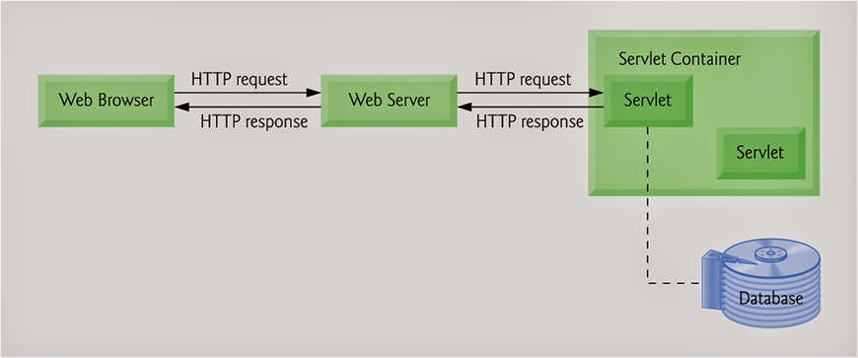
Dynamic web pages
November 4, 2023
SE ZG651/ SS ZG653 Software Architectures

Slide 31
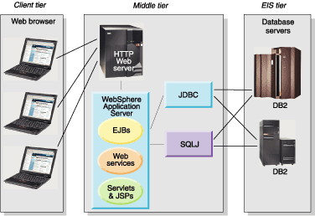
Web application architecture
HTTP
or
HTTPS
November 4, 2023
SE ZG651/ SS ZG653 Software Architectures

Slide 32
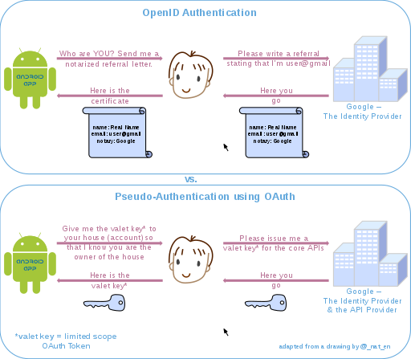
Source: Wikipedia
November 4, 2023
SE ZG651/ SS ZG653 Software Architectures

